Slide 1

COMICS BOOK CATALOGUE MANAGEMENT SYSTEM
Guided by,
Ms.M.Indhu
Ass.proffeser
ECE/KRCE
MELVINA A
ECB2301
I - year
KRCE

Slide 2

COMIC BOOK
CATALOGUE
MANAGEMENT SYSTEM

Slide 3
INTRODUCTION
In this presentation, we will explore how Python programming can optimize the management of comic book catalogues.
We will delve into the benefits of using Python for data manipulation and organization, and how it can streamline the process for comic book enthusiasts and collectors.

Slide 4

CHALLENGES IN CATALOGUE MANAGEMENT
Managing a large collection of comic books can be overwhelming. With the help of Python, we can automate tasks such as sorting, categorizing, and updating information, making the process more efficient and less time-consuming for collectors.

Slide 5

DATA MANIPULATION WITH PYTHON
Using Python libraries such as Pandas and NumPy, we can easily manipulate and analyze large datasets of comic book information.
This allows for quick updates, data cleaning, and statistical analysis to gain insights into the collection.

Slide 6

AUTOMATING CATALOGUE UPDATES
By leveraging Python scripts, we can automate the process of updating catalogue information, such as adding new acquisitions, removing duplicates, and keeping track of comic book values. This saves time and ensures that the catalogue is always up to date.

Slide 7

VISUALIZING CATALOGUE DATA
With the help of Python libraries like Matplotlib and Seaborn, we can create visual representations of the comic book collection data.
This allows for better understanding of trends, value distribution, and insights into the collection.

Slide 8
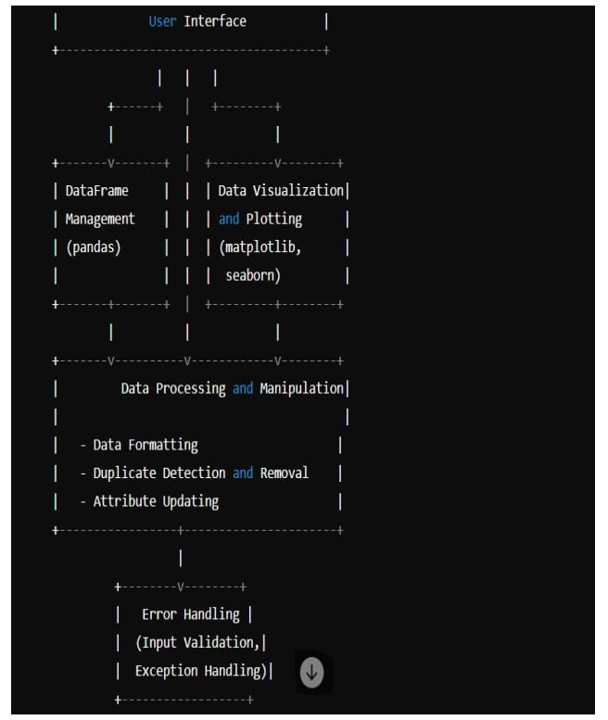

Slide 9
SOURCE CODE
import pandas as pd
import numpy as np
import matplotlib.pyplot as plt
import seaborn as sns
# Create an initial DataFrame
data = {
'Title': ['Spider-Man', 'Batman', 'Superman'],
'Issue_Number': [1, 2, 3],
'Volume': [1, 1, 1],
'Publisher': ['Marvel', 'DC', 'DC'],
'Publication_Date': ['2020-01-01', '2021-05-05', '2022-03-03'],
'Genre': ['Action', 'Action', 'Adventure'],
'Price': [3.99, 4.99, 5.99]
}
comics_df = pd.DataFrame(data)
comics_df['Publication_Date'] = pd.to_datetime(comics_df['Publication_Date'])

Slide 10
# Function to add a new acquisition
def add_comic(title, issue_number, volume, publisher, publication_date, genre, price):
global comics_df
new_comic = pd.DataFrame({
'Title': [title],
'Issue_Number': [issue_number],
'Volume': [volume],
'Publisher': [publisher],
'Publication_Date': [pd.to_datetime(publication_date)],
'Genre': [genre],
'Price': [price]
})
comics_df = pd.concat([comics_df, new_comic], ignore_index=True)
# Function to remove duplicates
def remove_duplicates():
global comics_df
comics_df = comics_df.drop_duplicates(subset=['Title', 'Issue_Number', 'Volume'], keep='last')
comics_df=comics_df.dropna(subset=['Price'])
comics_df=comics_df[comics_df['Price'] !=0]

Slide 11
# Function to update comic information
def update_comic(index, title=None, issue_number=None, volume=None, publisher=None, publication_date=None, genre=None, price=None):
global comics_df
if title:
comics_df.at[index, 'Title'] = title
if issue_number:
comics_df.at[index, 'Issue_Number'] = issue_number
if volume:
comics_df.at[index, 'Volume'] = volume
if publisher:
comics_df.at[index, 'Publisher'] = publisher
if publication_date:
comics_df.at[index, 'Publication_Date'] = pd.to_datetime(publication_date)
if genre:
comics_df.at[index, 'Genre'] = genre
if price:
comics_df.at[index, 'Price'] = price

Slide 12
# Function to visualize the data
def visualize_data():
plt.figure(figsize=(10, 6))
#Distribution of prizes
plt.subplot(1, 2, 1)
sns.histplot(comics_df['Price'], kde=True, color='blue')
plt.title('Price Distribution’)
#Count of comics by publishers
plt.subplot(1, 2, 2)
sns.countplot(y='Publisher', data=comics_df, palette='viridis')
plt.title('Comics by Publisher')
plt.tight_layout()
plt.show()
# Example usage
add_comic('Barbie',4,1,'Disney','2023-01-01','Animation',2.99)
add_comic('Wonder Woman', 1, 1, 'DC', '2022-01-01', 'Action', 4.99)
add_comic('Spider-Man', 1, 1, 'Marvel', '2020-01-01', 'Action', 3.99) # Duplicate
remove_duplicates()
update_comic(2,price=1.99)
print(comics_df)
visualize_data()

Slide 13
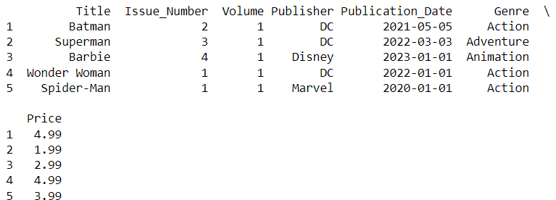
OUTPUT

Slide 14
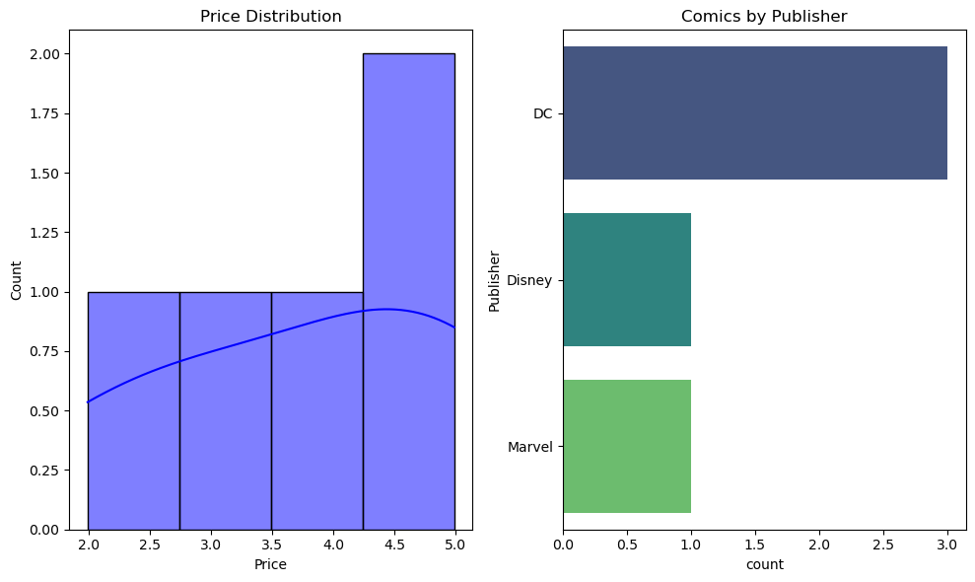

Slide 15
CONCLUSION
In conclusion, Python programming offers powerful tools for optimizing the management of comic book catalogues.
By automating tasks, manipulating data, and visualizing information, collectors can enhance their cataloguing process and gain valuable insights into their collections.

Slide 16


